Slide 1
CAPSTONE PROJECT PRESENTATION
‘Students’ Early Attrition Modelling for
Clearwater State University’
Author: nithin.janardhana3@gmail.com

Slide 2
PROBLEM STATEMENT
Clearwater State University offers a wide variety of degree programs, from online degrees to a doctorate in education.
Our Goal is to build a predictive Model to identify students with higher early attrition risk considering the given data and Recommend appropriate interventions based on the analysis .

Slide 3



EXPLORATORY
DATA ANALYSIS
Exploratory data analysis is an approach to analyze data sets to summarize their main characteristics, with visual methods.
6

Slide 4
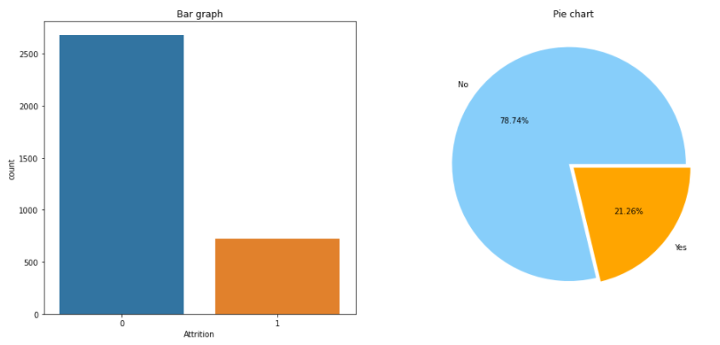
UNIVARIATE ANALYSIS
INFERENCES
(Target Variable : Attrition)
The Response variable is imbalanced data.
Only 21.3% of overall records are likely to drop out

Slide 5
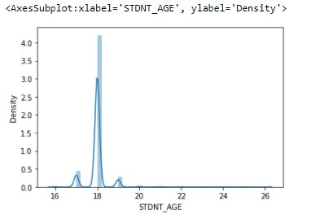
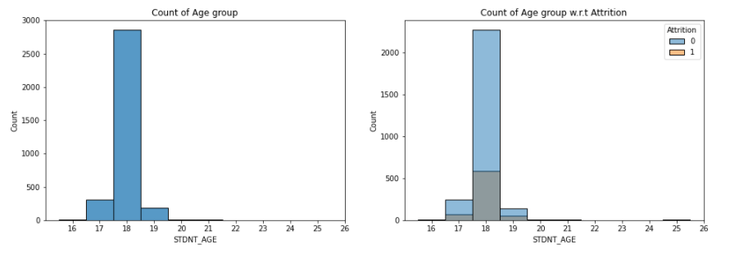
INFERENCES: Students of Age group 18 are in high numbers and the it is observed that the students of the same age group are likely to drop out more. Males are more interested in Vehicle insurance when compared with female. Chances of male buying a vehicle insurance is high compared to female. So we may have to concentrate more on male customers.
STDNT_AGE:

Slide 6
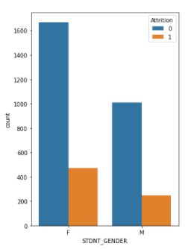
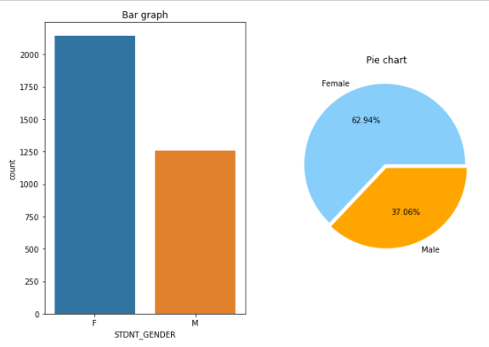
INFERENCES: Students who areFemale tends to attrition compared to male. The enrolment of Females are more. Males are more interested in Vehicle insurance when compared with female. Chances of male buying a vehicle insurance is high compared to female. So we may have to concentrate more on male customers.
STDNT_GENDER:

Slide 7
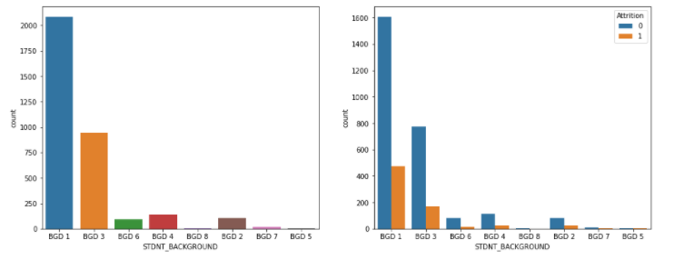
INFERENCES: More students are from BGD1 & more attrition is also from BGD1. Student from BGD5 have 50% attrition Rate. Males are more interested in Vehicle insurance when compared with female. Chances of male buying a vehicle insurance is high compared to female. So we may have to concentrate more on male customers.
STDNT_BACKGROUND:

Slide 8
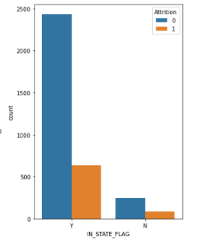
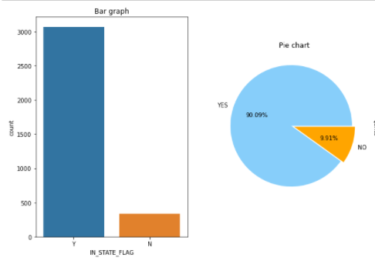
INFERENCES: Many students are from same state and many student from same state have left the course. Males are more interested in Vehicle insurance when compared with female. Chances of male buying a vehicle insurance is high compared to female. So we may have to concentrate more on male customers.
IN_STATE_FLAG:

Slide 9
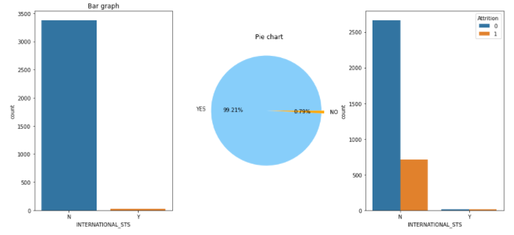
INFERENCES: Many students are from same country and many student from same country have left the course. International status is not making much difference to the data. Males are more interested in Vehicle insurance when compared with female. Chances of male buying a vehicle insurance is high compared to female. So we may have to concentrate more on male customers.
INTERNATIONAL_STS:

Slide 10
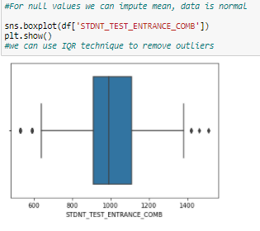
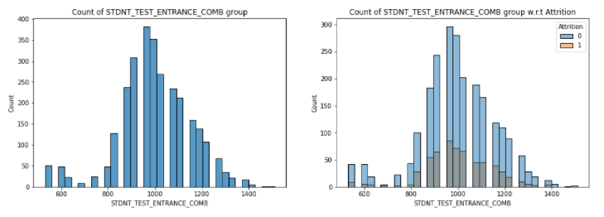
INFERENCES: We can consider combined entrance marks. As entrance result 1 and 2 lead sums up to TEST_ENTRANCE_COMB Males are more interested in Vehicle insurance when compared with female. Chances of male buying a vehicle insurance is high compared to female. So we may have to concentrate more on male customers.
STDNT_TEST_ENTRANCE_COMB:

Slide 11
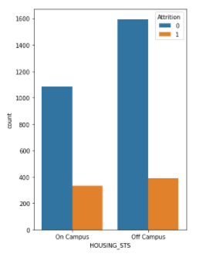
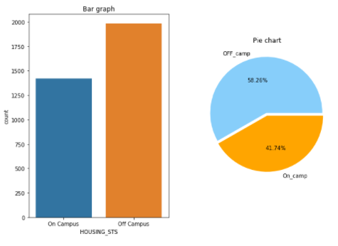
INFERENCES: Student dropping out of college are almost the same when it comes to On campus and Off campus. Males are more interested in Vehicle insurance when compared with female. Chances of male buying a vehicle insurance is high compared to female. So we may have to concentrate more on male customers.
HOUSING_STS :

Slide 12
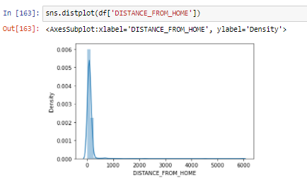

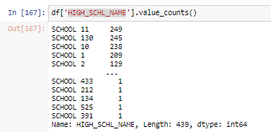
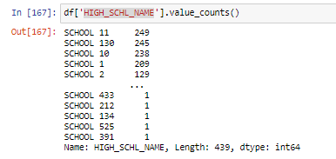
OTHER DEPENDANT VARIABLES:
DISTANCE_FROM_HOME:
HIGH_SCHL_GPA:
HIGH_SCHL_NAME:
FATHER_HI_EDU_CD:

Slide 13
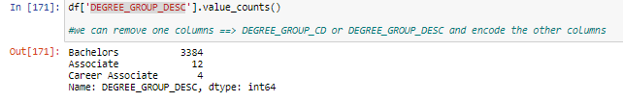
OTHER DEPENDANT VARIABLES:
DEGREE_GROUP_DESC:

Slide 14
Data Pre-Processing
REDUNTANT VARIABLES:
STUDENT IDENTIFIER column is in-significant.
So, we will drop that column
from dataset.
STDNT_MINOR can be removed 93% students have no minor subject.
SECOND_TERM can be removed as it is co-linear with FIRST_TERM.
Created Two new columns
a) No_sub_first_term
b) No_sub_second_term
These are to count the number of subjects taken in each term. Hence we can drop all the columns that show Course name and Course grade(Almost all students taking courses have completed).
GROSS_FIN_NEED can be removed as we already have a column UNMET_NEED which can be used instead.

Slide 15
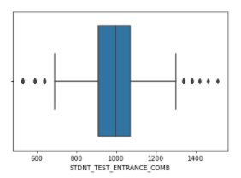
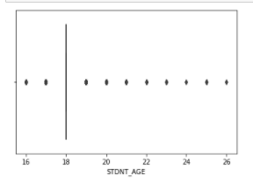
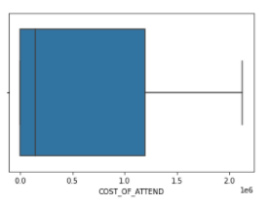
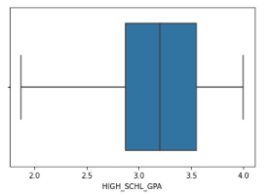

Outlier-Treatment
Outliers
HIGH_SCHL_GPA : Row with 0 have been removed.
Age and Student test Combination is kept as is as it helps in showing us variation in data.
I have used the Power transform to reduce the outlier in the dataframe

Slide 16
Slide 7
FEATURE
SELECTION
35%
25%
43%
Feature Selection is the process where we automatically or manually select those features which contribute most to your prediction variable or output in which we are interested in. Having irrelevant features in the data can decrease the accuracy of the models and make the model learn based on irrelevant features.
18

Slide 17
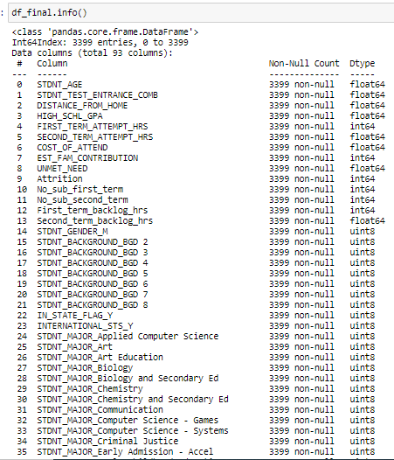
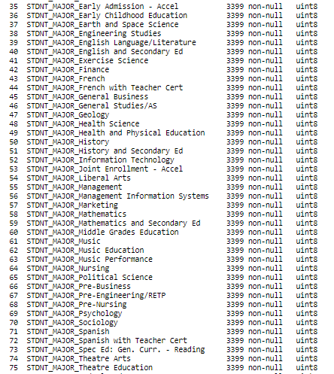
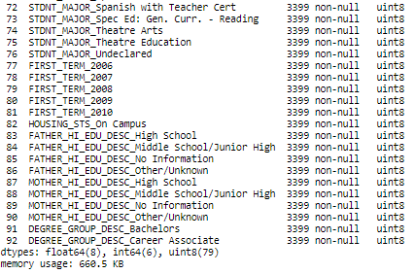
Final List of Features -Selected for the Regression

Slide 18

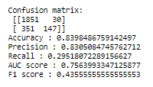
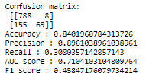
Using train and test split
BASE MODEL
Accuracy:
MACHINE LEARNING
LOGISTIC REGRESSION
Test accuracy score: 84.01 %
Threshold: 0.50
CONFUSION MATRIX AND PREDICTION SCORES:
Logistic regression is a statistical model that in its basic form uses a logistic function to model a binary dependent variable, although many more complex extensions exist. In regression analysis, logistic regression (or logit regression) is estimating the parameters of a logistic model (a form of binary regression).
Train data
Test data
20

Slide 19
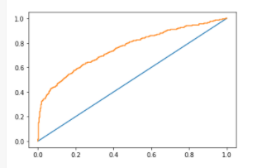
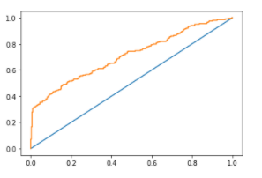
LOGISTIC REGRESSION
BASE MODEL
We can observe that the AUC value for our base model is 71.04%
21

Slide 20
Logistic Regression
MODELS PERFORMED
Decision Tree Classifier
Random Forest Classifier

Slide 21
Final Model
We find out we got better result on Logistic Regression for data without SMOTE analysis, we will use the same dataset
• Decision Tree model results before and after hyperparameter tuning is same.
• This model perform relatively better than other models.
• Based on our metric we have used, we can say our model is good fit than other models.
Train
Accuracy_score_train : 0.8394
AUC Score :
f1_score_train : 0.4355
precision_score_train : 0.8305
recall_score_train : 0.2951
Test
Accuracy_score_test : 0.8401
f1_score_test : 0.4584
precision_score_test : 0.8961
recall_score_test : 0. 3080
Logistic Regression:

Slide 22
EDA: We have features which are important for predicting whether a student would drop out of the college early or not . Then the college can accordingly plan its strategy to make sure that these set of students can continue and help in increasing the progression and graduation rates.
Feature importance:
1.STDNT_AGE < 20 2. STDNT_GENDER
3.STDNT_MAJOR_Music 4. STDNT_MAJOR_Engineering
5. INTERNATIONAL_STS_Y 6. HOUSING_STS_On Campus
7. FATHER_HI_EDU_DESC_Middle School/Junior High
Recommendation
Observations:
Female students who are above 19 years of age tend to drop out more than male students. Such students can be offered more beneficiaries like more financial aids, In campus accommodations, etc.
Students who have taken up music as their subject tend to drop out more due their interest in music.
Housing on campus can help use prevent the attrition rate.
Father’s educational qualification has an impact on student’s attrition rate. So extra parental counselling can be done to help their children continue the course.

Slide 23
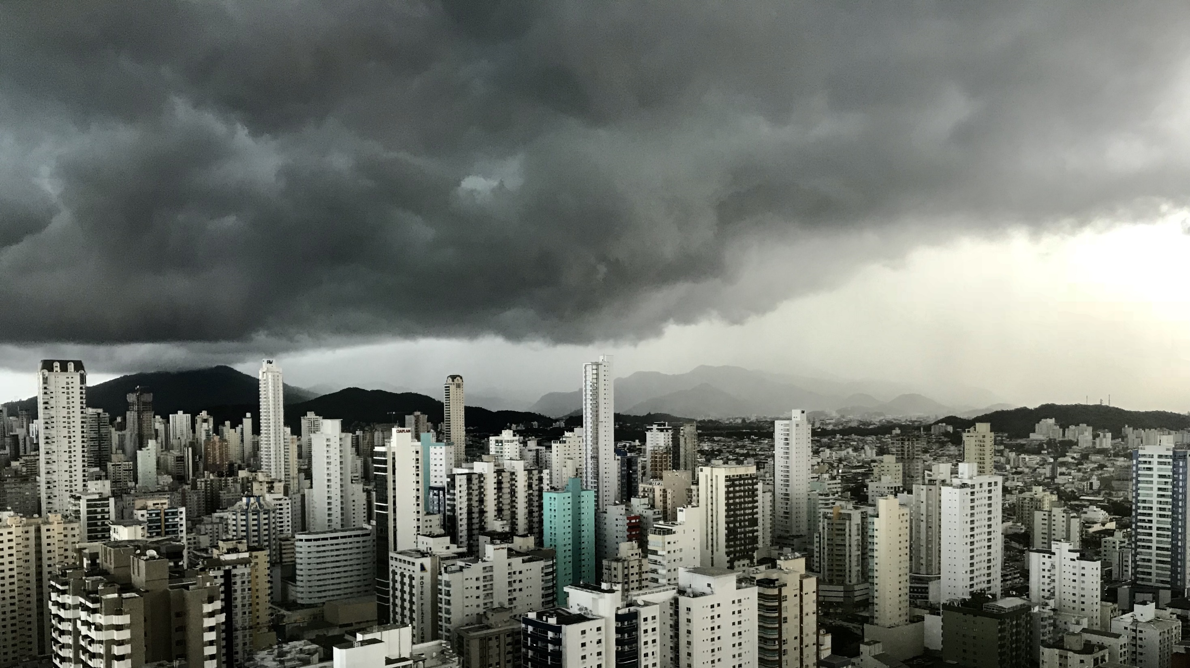
Slide 11
S
THANK YOU

